Slide 1

Statistic of Data
Anshu Pandey

Slide 2

Objectives
After completing this module, you should be able to:
Measure of Central Tendency – Mean, Mode and Median
Measure of Spread – IQR, Variance and Standard Deviation
Covariance
Correlation
Measure of Shape - Kurtosis, Skewness

Slide 3
Some Important Terms
Population: A collection of persons, objets or items. E.g. All Automobiles, All employees of Microsoft
Census: When researchers gathers data from whole population for a given measurement of interest they call it census. E.g. US Population Census taken every 10 years
Sample: A portion of whole or representative of the whole population. E.g. 75 samples of Dairymilks for testing quality

Slide 4
Some Important Terms
Descriptive Statistics: Using data gathered on a group to reach conclusion about the same group.
Inferential Statistics: gathering data from a sample and use the statistics to bring conclusions about the population.

Slide 5
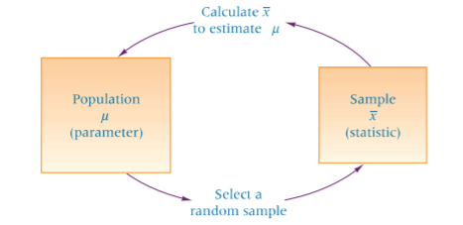

Slide 6
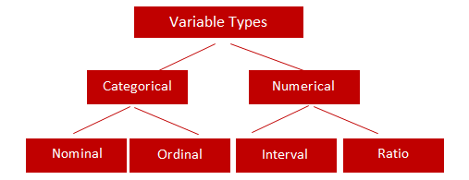
Types of Variables

Slide 7
Types of Variables

Slide 8
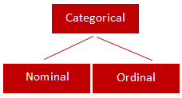
Categorical
Qualitative data are often termed categorical data. Data that can be added into categories according to their characteristics.
Nominal Variable (Unordered list) A variable that has two or more categories, without any implied ordering. Examples : Gender - Male, Female
Marital Status - Unmarried, Married, Divorcee
State - New Delhi, Haryana, Illinois, Michigan
Ordinal Variable (Ordered list) A variable that has two or more categories, with clear ordering. Examples :
Scale - Strongly Disagree, Disagree, Neutral, Agree, Strongly Agree
Rating - Very low, Low, Medium, Great, Very great

Slide 9
Continuous Variables

Slide 10
Ratio
It is interval data with a natural zero point. When the variable equals 0.0, there is none of that variable. Examples :
Height
Weight
Temperature in Kelvin - It is a ratio variable, as 0.0 Kelvin really does mean 'no temperature.

Slide 11
Interval
An interval variable is similar to an ordinal variable, except that the intervals between the values of the interval variable are equally spaced. In other words, it has order and equal intervals. Examples :
Temperature in Celsius - Temperature of 30°C is higher than 20°C, and temperature of 20°C is higher than 10°C. The size of these intervals is the same.
Annual Income in Dollars - Three people who make $5,000, $10,000 and $15,000. The second person makes $5,000 more than the first person and $5,000 less than the third person, and the size of these intervals is the same.

Slide 12
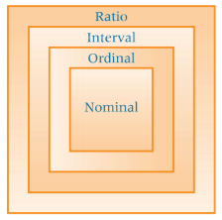
Variables

Slide 13
Descriptive Statistics
Descriptive statistics answer the following questions:
What is the value that best describes the data set?
How much a data set speads from its average value?
What is the smallest and largest number in a data set?

Slide 14
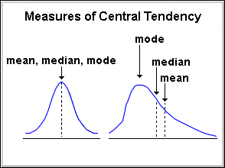
What is central tendency?
Central Tendency are measures the location of the middle or the center of a distribution.
It’s value describe whether your data are spread out or packed together.

Slide 15
Central Tendency
It represent or indicates where the center of distribution tends to be.
Where to use Central Tendency
Simplification
It give a single value which can be best representor of your data.
Prediction
It help to predict a new result which is not present in your data.

Slide 16
Calculation of Central Tendency - Mean
Central Tendency can be calculate through Mean, Median and Mode of data set.
Mean
The mean (or average) is the most popular and well known measure of central tendency.
The mean is equal to the sum of all the values in the data set divided by the number of values in the data set.

Slide 17

Calculation of Mean
If we have n values in a data set and they have values x1, x2, ..., xn, the sample mean, usually denoted by (pronounced x bar), is:

Slide 18
Median
The median is the middle score for a set of data that has been arranged in order of magnitude.

Slide 19
Calculation of Median
Case 1
55 89 56 35 14 56 55 87 45 92
Here we first need to rearrange that data into order of magnitude (smallest first):
35 45 55 55 56 56 65 87 89 92
In this case middle value is 56.

Slide 20
Calculation of Median
Case 2
65 55 89 56 35 14 56 55 87 45
We again rearrange that data into order of magnitude (smallest first):
14 35 45 55 55 56 56 65 87 89
Now we have 5th and 6th score in our data set are middle so, we will take average value to calculate middle value 55.5.

Slide 21
Mode
The mode is the most frequent score in our data set.
On a histogram it represents the highest bar in a bar chart or histogram.
Sometimes consider the mode as being the most popular option.

Slide 22
Choosing the best measure of Central Tendency
Mean – When your data is not skewed i.e normally distributed. In other words, there are no extreme values present in the data set (Outliers).
01
Median – When your data is skewed or you are dealing with ordinal (ordered categories) data (e.g. like 1. Strongly dislike 2. Dislike 3.Neutral 4. Like 5. Strongly like)
02
Mode - When dealing with nominal (unordered categories) data.
03
Example In real life, suppose a company is considering expanding into an area and is studying the size of containers that competitors are offering. They would be more interested in the mode because they want to know what size tends to sell most often.
Notes:
Note:- Outlier means a data value that is distinctly separate from rest of data.

Slide 23
Question 11
Many changes continue to occur in the healthcare industry. Because of increased competition for patients among providers and the need to determine how providers can better serve their clientele, hospital administrators sometimes administer a quality satisfaction survey to their patients after the patient is released.
The following types of questions are sometimes asked on such a survey. These questions will result in what level of data measurement?
How serious was your condition when you were first admitted to the hospital?
__Critical __Serious __Moderate __Minor
Ratio
Interval
Nominal
Ordinal

Slide 24
Question 11
Many changes continue to occur in the healthcare industry. Because of increased competition for patients among providers and the need to determine how providers can better serve their clientele, hospital administrators sometimes administer a quality satisfaction survey to their patients after the patient is released.
The following types of questions are sometimes asked on such a survey. These questions will result in what level of data measurement?
How serious was your condition when you were first admitted to the hospital?
__Critical __Serious __Moderate __Minor
Ratio
Interval
Nominal
Ordinal
Answer: D

Slide 25
Imagine a situation where a real estate agent wants a measure of the central tendency of homes she has sold in the last year. She makes a list of all of the totals:
$75,000
$75,000
$150,000
$155,000
$165,000
$203,000
$750,000
$755,000
Which would you say is the best measure of central tendency of the set of sales numbers?

Slide 26
Question 10
Which of the data samples may have highest chances of outliers?
The data of salary of delivery boys in Dominos
Data of Age of people in an old age Home.
The data of income tax filed by citizens of Mumbai
The data of cost of vegetables in a super market.

Slide 27
Question 10
Which of the data samples may have highest chances of outliers?
The data of salary of delivery boys in Dominos
Data of Age of people in an old age Home.
The data of income tax filed by citizens of Mumbai
The data of cost of vegetables in a super market.
Answer: C

Slide 28
Two weeks before Mark opened Technology Titans, he launched his company Web site.
During those 14 days, Mark had an average of 24.5 hits on his Web site per day. In the first two days that Technology Titans was open for business, the Web site received 42 and 53 hits respectively.
Determine the new average for hits on the Web site

Slide 29

Percentile
Percentiles are measures of central tendency that divide a group of data into 100 parts.
There are 99 percentiles because it takes 99 dividers to separate a group of data into 100 parts.The nth percentile is the value such that at least n percent of the data are below that value and at most (100 - n) percent are above that value.

Slide 30
Variance, Standard Deviation and IQR

Slide 31
Variance, Standard Deviation and IQR
Variance, Standard Deviation and IQR of any data measure of how spread out a data set is.

Slide 32
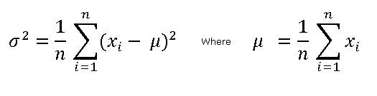
Variance and Standard Deviation
Standard Deviation and Variance used to measure how far away individual data points are from mean or average of data set.

Slide 33
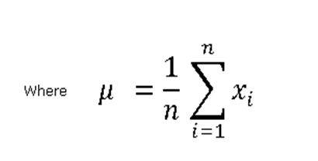
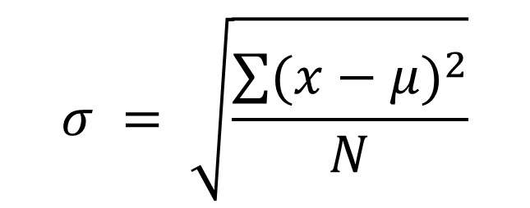
Standard Deviation:- Square root of variance
$$σ = \sqrt{\frac{\sum{{(x−μ)}^{2}}}{N}}$$

Slide 34
Question 10
Which of the data samples may have highest chances of outliers?
The data of salary of delivery boys in Dominos
Data of Age of people in an old age Home.
The data of income tax filed by citizens of Mumbai
The data of cost of vegetables in a super market.
Answer: C

Slide 35
Covariance

Slide 36
Covariance
A covariance refers to the measure of how two random variables will change together and is used to calculate the correlation between variables. In a finance context, covariance is the term used to describe how two stocks will move together.

Slide 37
Positive, Negative and Zero Covariance
A positive covariance indicates that both tend to move upwards in value and downwards in value at the same time.
Negative covariance means they will move counter to each other, when one rises, the other falls.
Zero covariance means that two random variable(in which we want to find covariance) are independent to each other. .

Slide 38
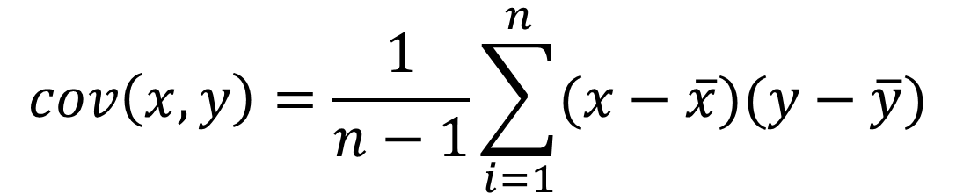
Calculation of Covariance
$$cov\left(x,y\right)=\frac{1}{n−1}\sum_{i=1}^{n}{(x−\overline{x})(y−\overline{y})}$$

Slide 39
Correlation

Slide 40
Correlation
Correlation is used to test relationships between quantitative variables or categorical variables. In other words, it’s a measure of how things are related.
The study of how variables are correlated is called correlation analysis.
Correlations are useful because if you can find out what relationship variables have, you can make predictions about future behavior.

Slide 41
Correlation
A correlation coefficient is a way to put a value to the relationship. Correlation coefficients have a value of between -1 and 1.
A “0” means there is no relationship between the variables at all.
while -1 or 1 means that there is a perfect negative or positive correlation.

Slide 42
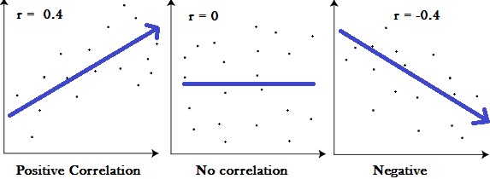
Correlation

Slide 43
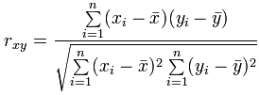
Calculate:- Correlation

Slide 44
Kurtosis, Skewness

Slide 45
Skewness:- Lack of symmetry
It’s means it measure how far normal distributed data from symmetrical data.
It’s give the idea about shape of data set.
In symmetry distributed data both side from mean value data remain same.

Slide 46

Normal Distribution or 0 skewness
In this case
Mean=Median=Mode=0
Normal distribution Symmetrical Skewness = 0

Slide 47

Negative Skewness
A left-skewed distribution has a long left tail.
Left-skewed distributions are also called negatively-skewed distributions.
That’s because there is a long tail in the negative direction on the number line.
In this case
Mode>Median>mean
Negatively skewed distribution or Skewed to the left Skewness <0

Slide 48

Positive Skewness
A right-skewed distribution has a long right tail.
Right-skewed distributions are also called positive-skew distributions.
That’s because there is a long tail in the positive direction on the number line.
In this case
Mean>Median>Mode
Positively skewed distribution or Skewed to the right Skewness > 0

Slide 49


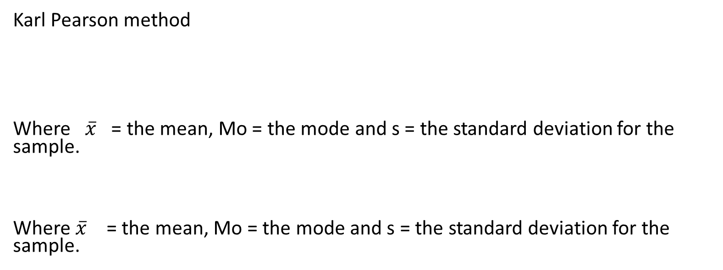
Calculation:- Coefficient of skewness
Karl Pearson method
Where $\overline{x}$ = the mean, Mo = the mode and s = the standard deviation for the sample.
Where $\overline{x}$ = the mean, Mo = the mode and s = the standard deviation for the sample.

Slide 50
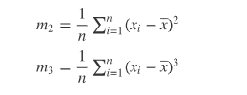


Calculation:- Coefficient of skewness
Skewness using moment coefficient
The moment coefficient of skewness based on beta
The moment coefficient of skewness based on gamma
Where m1 and m2 --

Slide 51
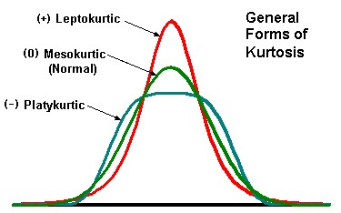
Kurtosis
Kurtosis is peakedness of distribution.
Based on distribution

Slide 52
Inferential Statistics

Slide 53
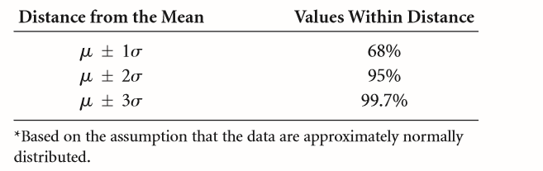
Empirical Rule
The empirical rule is an important rule of thumb that is used to state the approximate percentage of values that lie within a given number of standard deviations from the mean of a set of data if the data are normally distributed.

Slide 54
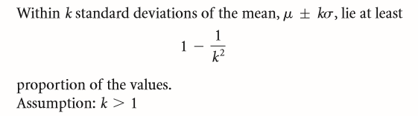
Chebyshev’s Theorem
The empirical rule applies only when data are known to be approximately normally distributed. What do researchers use when data are not normally distributed or when the shape of the distribution is unknown? Chebyshev’s theorem applies to all distributions regardless of their shape and thus can be used whenever the data distribution shape is unknown or is nonnormal.

Slide 55

Z Score
Scores A z score represents the number of standard deviations a value (x) is above or below the mean of a set of numbers when the data are normally distributed. Using z scores allows translation of a value’s raw distance from the mean into units of standard deviations.

Slide 56

Coefﬁcient of Variation
The coefﬁcient of variation is a statistic that is the ratio of the standard deviation to the mean expressed in percentage and is denoted CV.

Slide 57
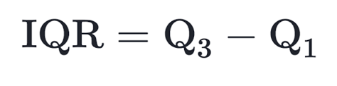
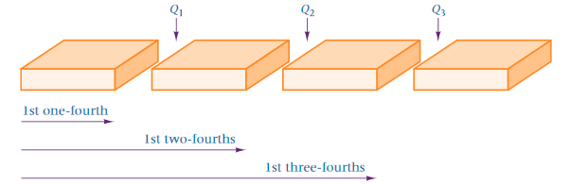
Interquartile Range (IQR)
Interquartile range is the amount of spread in the middle 50% of a dataset.
In other words, it is the distance between the first quartile Q1​ and the third quartile Q3​.

Slide 58
Calculation of IQR
Step 1: Put the data in order from least to greatest.
01
Step 2: Find the median.
02
Step 3: Find the first quartile Q1. The first quartile is the median of the data points to the left of the median in the ordered list.
03
Step 4: Find the third quartile Q3 The third quartile is the median of the data points to the right of the median in the ordered list.
04
Step 5: Calculate IQR by subtracting Q3 - Q1.
05
Notes:
Note:- Outlier means a data value that is distinctly separate from rest of data.

Slide 59

Conclusion:
Variance, Standard Deviation and IQR
Through Variance, Standard Deviation and IQR we can calculate spread out of data and knowing how far each data point lies from average allows you to make accurate conclusion about a data set, because you can pick out layers or extreme values.

Slide 60
Summary
This module covered the following topics:
Measure of Spread
Calculation of Mean
Working Median
Finding out Mode
Variance
Standard Deviation
IQR
Correlation
Skewness & Kurtosis

Slide 61

Thank you
Anshu Pandey

